Slide 1
Statistic Warmups
Source: http://www.hhmi.org/biointeractive/teacher-guide-math-and-statistics

Slide 2
Descriptive Statistics (what to do with data that makes a normal curve)
It is rarely practical for scientists to measure every event or individual in a population. Instead, they typically collect data on a sample of a population and use these data to draw conclusions (or make inferences) about the entire population. Statistics is a mathematical discipline that relates to this type of analysis.
Types of statistics used →

Slide 3
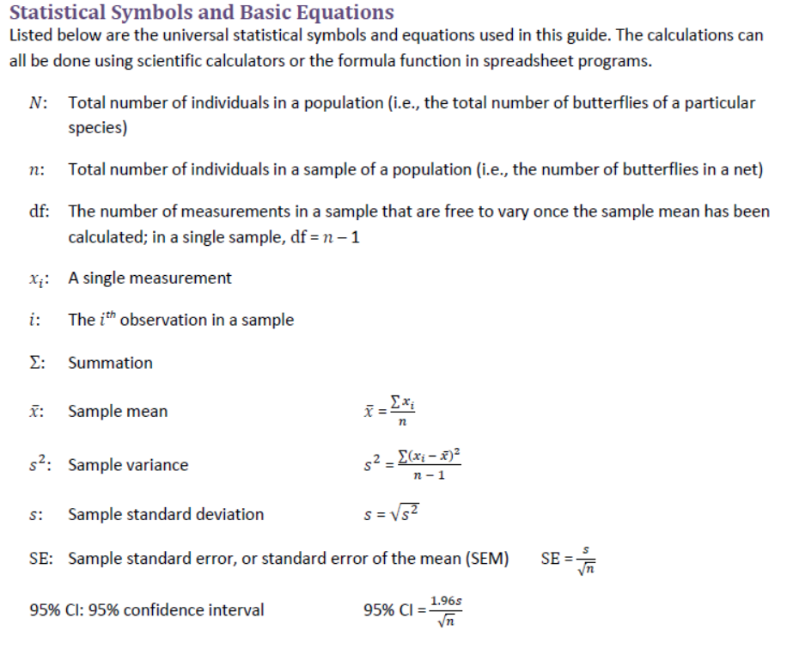

Slide 4
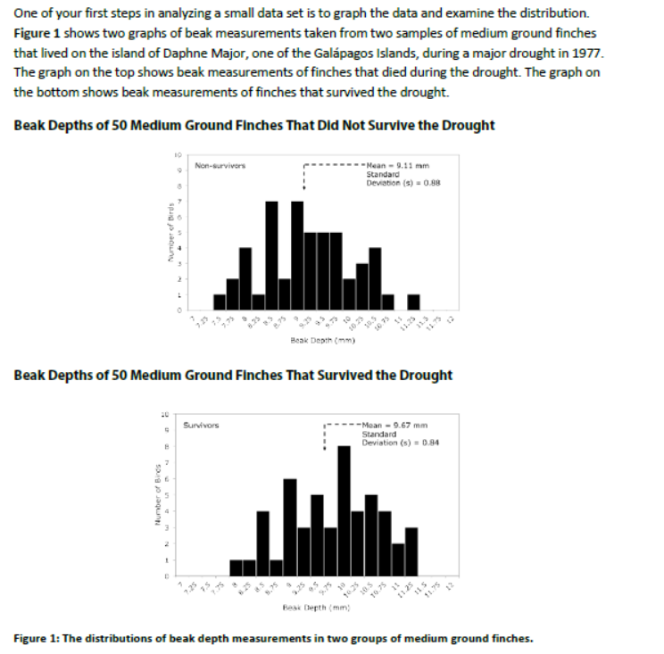

Slide 5
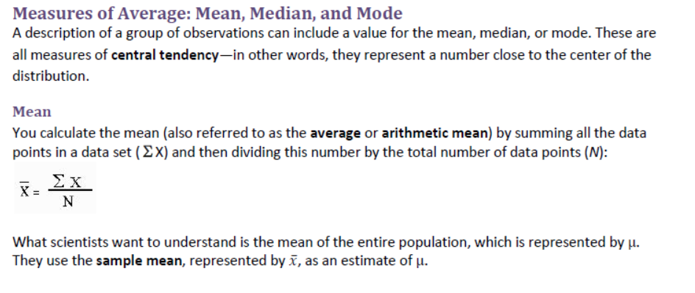

Slide 6
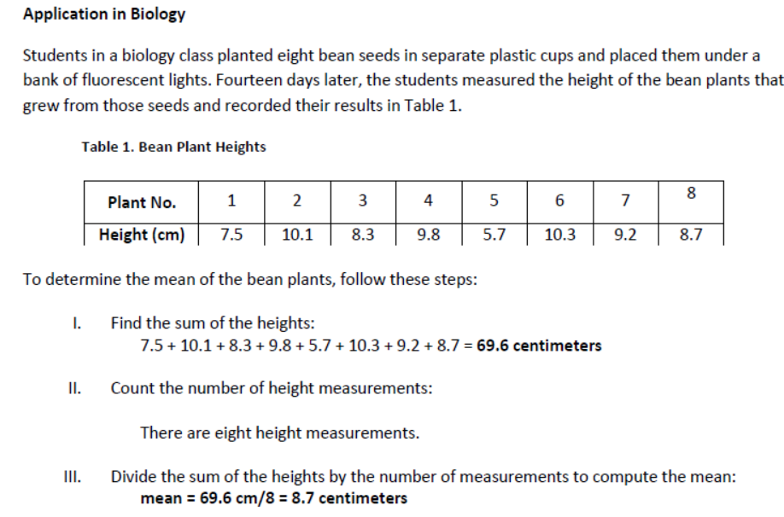

Slide 7
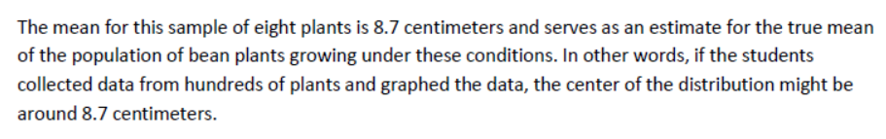

Slide 8
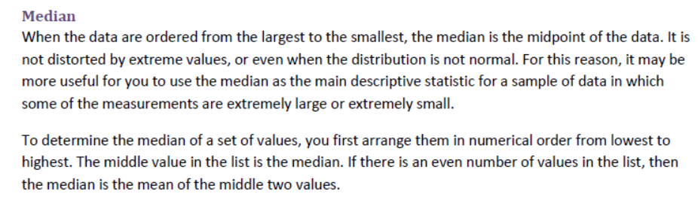
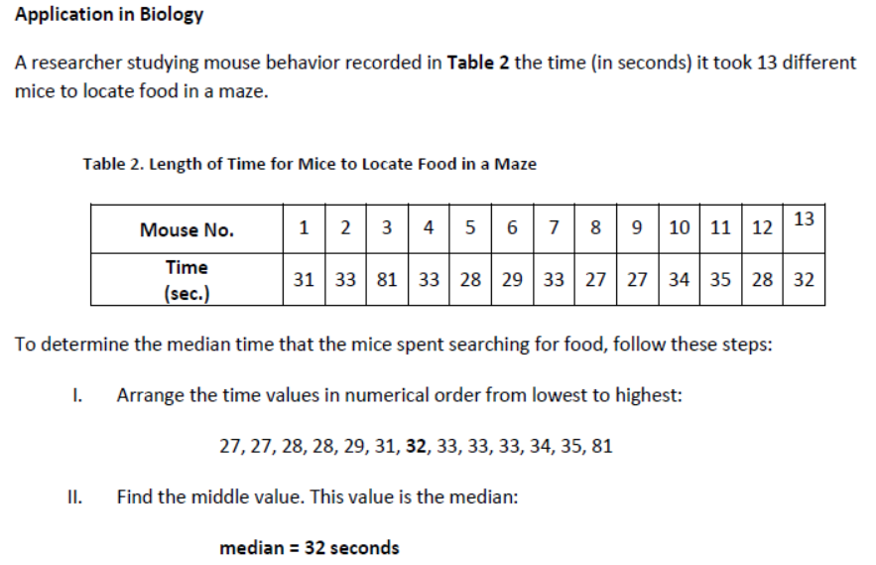

Slide 9
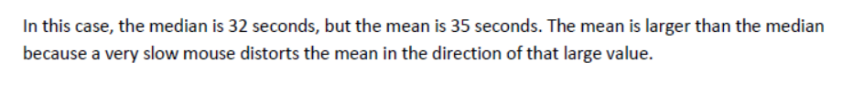

Slide 10
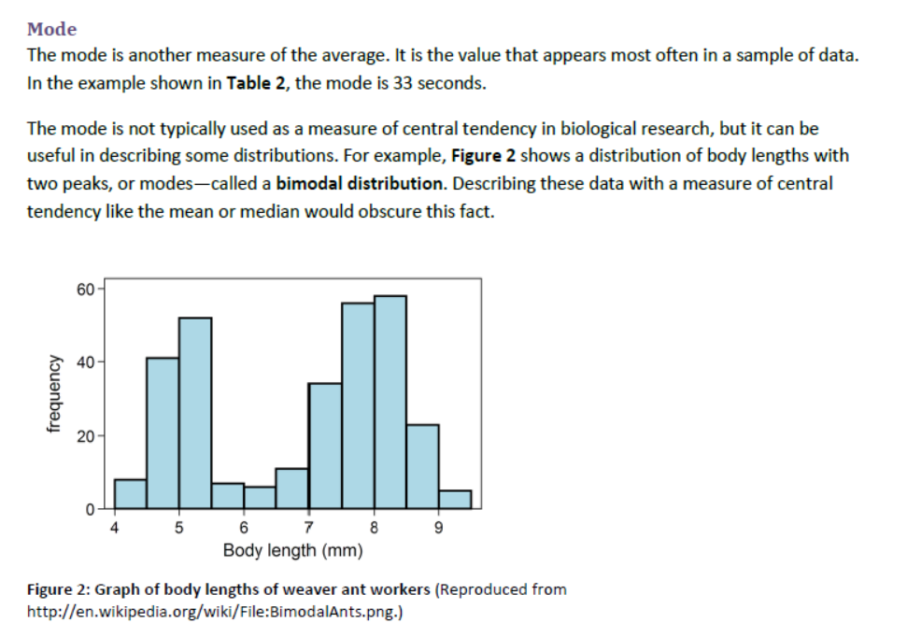

Slide 11
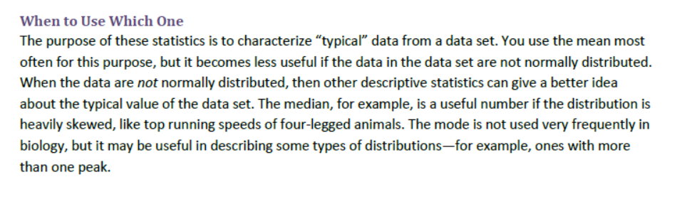

Slide 12
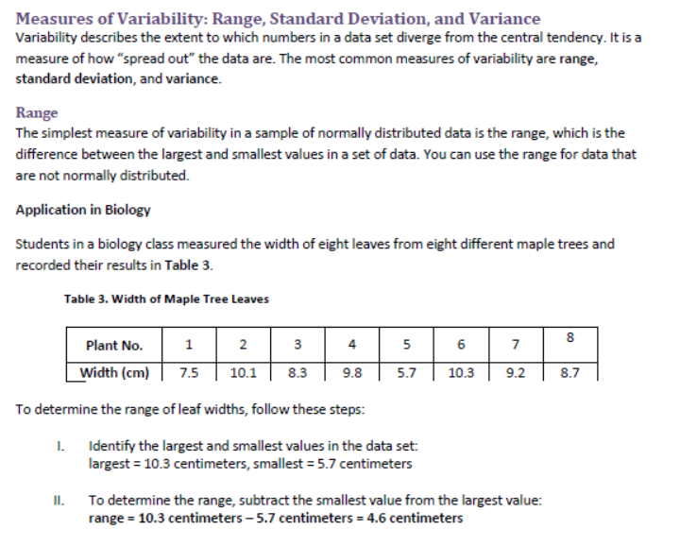

Slide 13
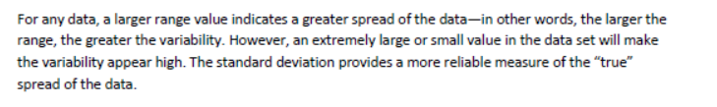

Slide 14
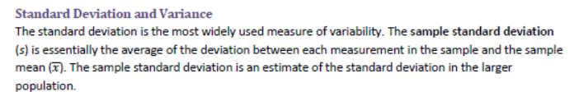
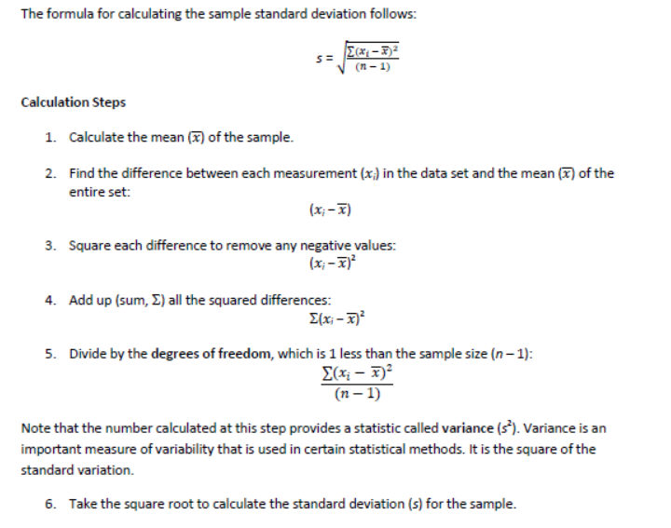

Slide 15
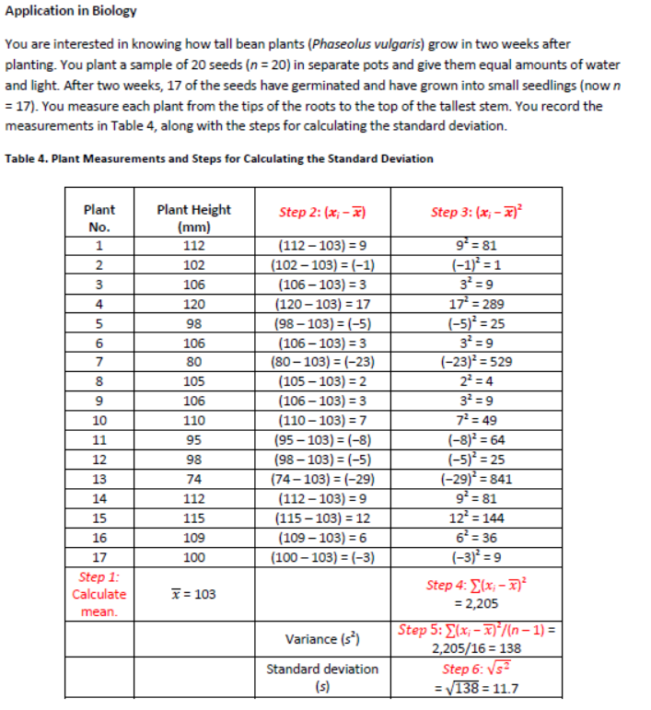

Slide 16
The mean height of the bean plants in this sample is 103 millimeters ± 11.7 millimeters. What does this tell us?
In a data set with a large number of continuous measurements that are normally distributed, 68% of the measurements are expected to fall within 1 standard deviation from the mean and 95% of all data points lie within 2 standard deviations of the mean on either side (Figure 3). Thus, in this example, if you assume that this sample of 17 observations is drawn from a population of measurements that are normally distributed, 68% of measurements in the population should fall between 91.3 and 114.7 millimeters and 95% of the measurements should fall between 80.1 millimeters and 125.9 millimeters.

Slide 17
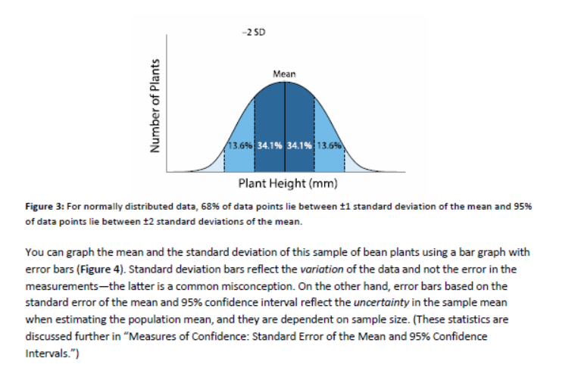

Slide 18
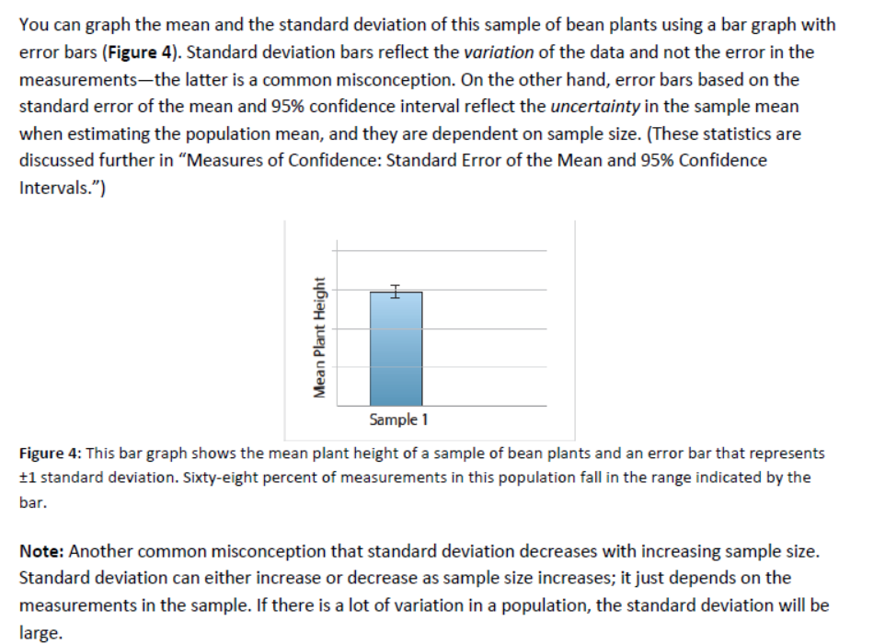

Slide 19
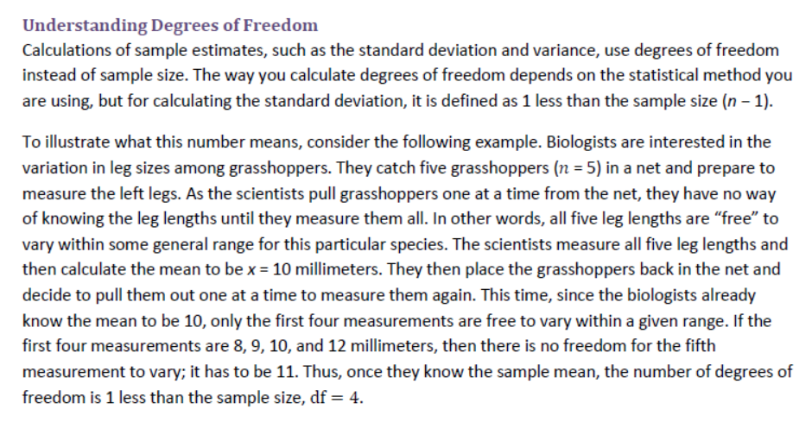

Slide 20
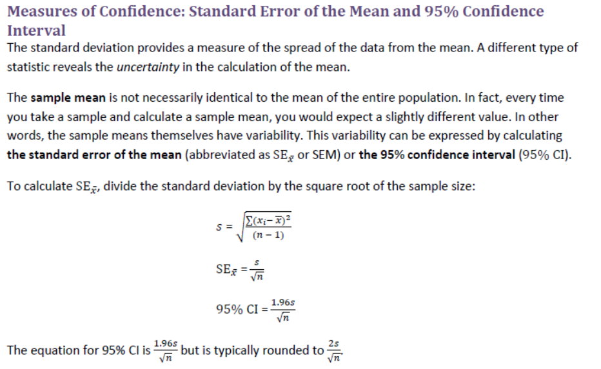

Slide 21
Assume that there is a population of a species of anole lizards living on an island of the Caribbean. If you were able to measure the length of the hind limbs of every individual in this population and then calculate the mean, you would know the value of the population mean. However, there are thousands of individuals, so you take a sample of 10 anoles and calculate the mean hind limb length for that sample. Another researcher working on that island might catch another sample of 10 anoles and calculate the mean hind limb length for this sample, and so on. The sample means of many different samples would be normally distributed. The standard error of the mean represents the standard deviation of such a distribution and estimates how close the sample mean is to the population mean. The greater the sample size (i.e., 50 rather than 10 anoles), the more closely the sample mean will estimate the population mean, and therefore the standard error of the mean becomes smaller.
The 95% confidence interval (95% CI) is equivalent to 1.96 (typically rounded to 2) standard errors of the mean. Because the sample means are assumed to be normally distributed, 95% of all sample means should fall between 2 standard deviations above and below the population mean, estimated by 95% CI.
What these calculations tell you is that you can be 68% confident that the population mean falls within ±1 standard error of the sample mean and 95% confident that the population mean falls within approximately ±2 standard errors of the sample mean.

Slide 22
Both SE𝑥̅ and 95% CI can be illustrated as error bars in a bar graph of the means of two or more samples that are being compared. Depicting SE𝑥̅ or the 95% CI as error bars in a bar graph provides a clear visual clue to the uncertainty of the calculations of the sample means.
Note: Unlike standard deviation, both standard error and 95% CI decrease with increasing sample size. In other words, the greater the sample size the less the uncertainty in the calculations of the sample means.

Slide 23
Application in Biology—Example 1
Seeds of many weed species germinate best in recently disturbed soil that lacks a light-blocking canopy of vegetation. Students in a biology class hypothesized that weed seeds germinate in response to light. To test this hypothesis, the students placed 25 seeds of crofton weed (Ageratina adenophora, an invasive species on several continents) in each of 20 petri dishes and covered them with distilled water. They placed half the petri dishes in the dark and half in the light. After 72 hours, the students counted the number of seeds that had germinated in each dish. The data and calculations of variance, standard deviation, standard error of the mean, and 95% confidence interval are shown in Table 5. The students plotted the data as two bar graphs showing the standard error of the mean and 95% confidence interval (Figure 5).

Slide 24
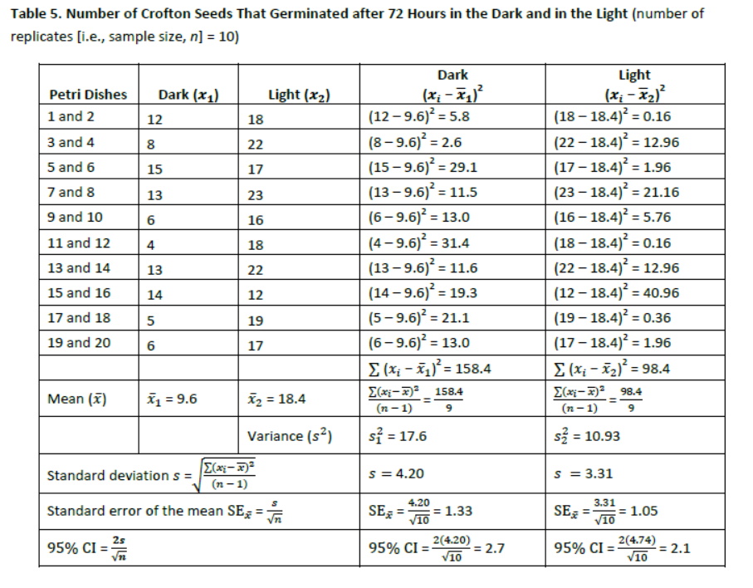

Slide 25
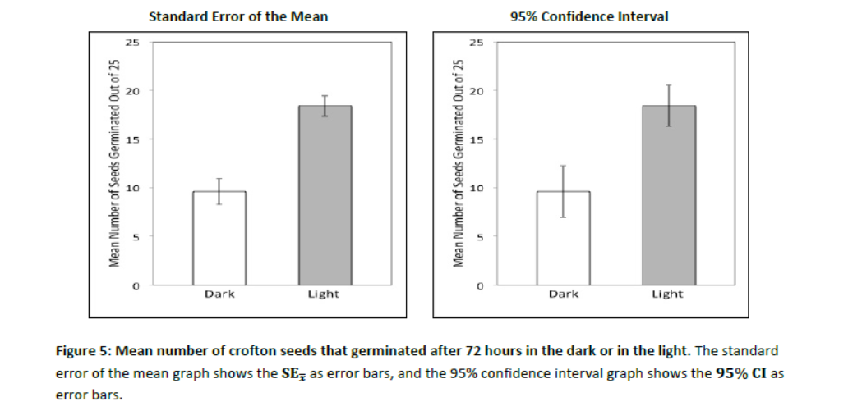

Slide 26
The calculations show that although the students don’t know how many seeds of the entire population of crofton seeds would germinate in the dark, it is likely to be a number around the sample mean of 9.6 seeds. But how confident are they of this estimate? They are 68% confident that the dark treatment population mean lies between 8.3 (9.6 − 1.3) and 10.9 (9.6 + 1.3) and that the light treatment population mean lies between 17.35 and 19.45 seeds. In addition, they are 95% confident that the dark treatment population mean lies between 7 and 12.2 seeds and the light treatment population mean lies between 16.3 and 21.5 seeds.
Note: By looking at the bar graphs, you can see that the means for the light and dark treatments are different. Can you tell if the differences are statistically significant? If the standard error bars and 95% CI bars overlap, then it is likely that the differences are not statistically significant. In this case, the standard error bars do not overlap; however, this does not necessarily mean that the difference between the means is statistically significant. On the other hand, the fact that the 95% confidence interval error bars do not overlap strongly suggests that the two sample means are significantly different. An additional statistical test, the sStudent’s t-test, is required to be sure.

Slide 27
Application in Biology—Example 2
A teacher had five students write their names on the board, first with their dominant hands and then with their nondominant hands. The rest of the class observed that the students wrote more slowly and with less precision with the nondominant hand than with the dominant hand. The teacher then asked the class to explain their observations by developing testable hypotheses. They hypothesized that the dominant hand was better at performing fine motor movements than the nondominant hand. The class tested this hypothesis by timing (in seconds) how long it took each student to break 20 toothpicks with each hand. The results of the experiment and the calculations of variance, standard deviation, standard error of the mean, and 95% confidence interval are presented in Table 6. The students then illustrated the data and uncertainty with two bar graphs, one showing the standard error of the mean and the other showing the 95% confidence interval (Figure 6).

Slide 28
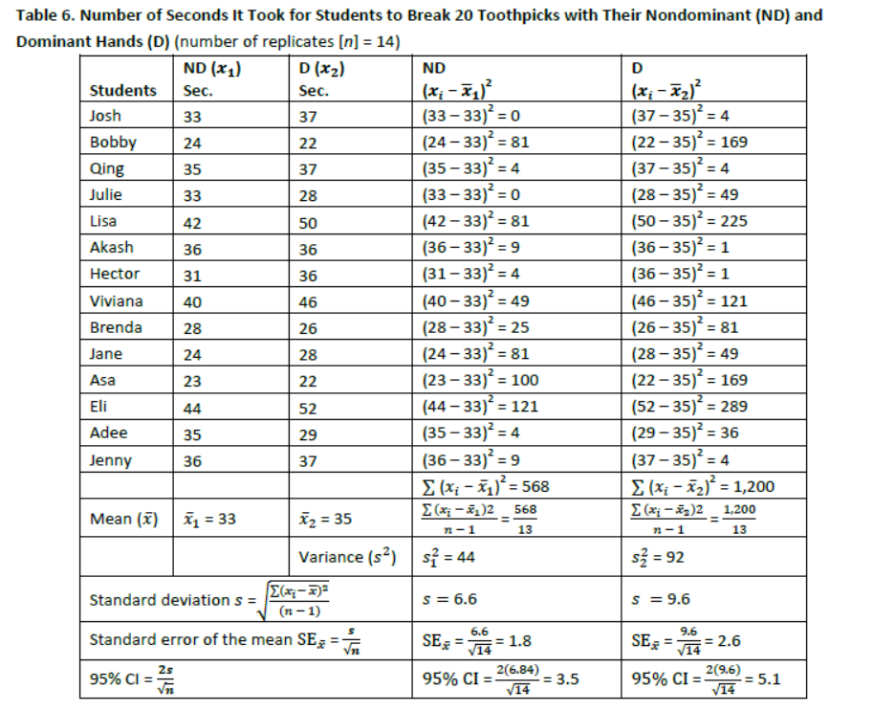

Slide 29
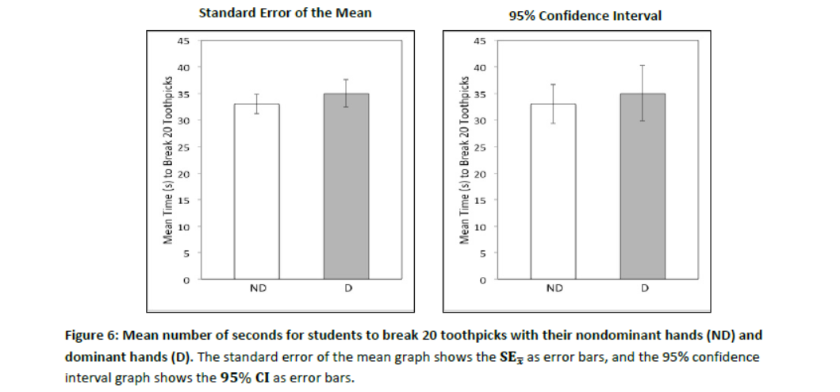

Slide 30
The calculations show that students can be 68% confident that the population mean for the nondominant hand treatment lies within 31.2 seconds (33 − 1.8) and 34.8 seconds (33 + 1.8). Likewise, for the dominant hand, students can be 68% confident that the population mean falls within 32.4 and 37.6 seconds.
Students are 95% confident that the population mean for the nondominant hands falls somewhere between 29.5 seconds (33 – 3.5) and 36.5 seconds (33 + 3.5) and that the population mean for the dominant hands falls somewhere between 29.9 seconds (35 – 5.1) and 40.1 seconds (35 + 5.1).
Note: The fact that the 95% confidence interval error bars for the two sample means overlap, so much so that they include the means, suggests that the two means may not be significantly different. Indeed, if a student reported that she broke 20 toothpicks with one hand, we could not conclude with confidence whether she used her dominant or her nondominant hand because 30 seconds is encompassed by both 95% confidence interval bars.

Slide 31
Inferential Statistics Used in Biology
Inferential statistics tests the statistical hypothesis, which is different from the experimental hypothesis. To understand what this means, assume that you do an experiment to test the experimental hypothesis that “nitrogen promotes plant growth.” To test this hypothesis, you grow 10 bean plants in dirt with added nitrogen and 10 bean plants in dirt without added nitrogen. You find out that the means of these two samples are 13.2 centimeters and 11.9 centimeters, respectively. Does this result indicate that there is a difference between the two populations and that nitrogen might promote plant growth? Or is the difference in the two means merely due to chance because of the 10 measurements collected? A statistical test is required to discriminate between these possibilities.
Statistical tests evaluate the null statistical hypothesis (symbolized by H0 and pronounced H-naught), that 𝑥̅1 = 𝑥̅2, and therefore by inference, μ1 = μ2. In other words, there is no real difference between the populations from which two experimental groups are sampled (i.e., there is no difference between the beans grown with and without nitrogen) and that any apparent difference has occurred by chance. The alternative hypothesis to H0 is symbolized by H1 and usually simply states that there is a difference.

Slide 32
Significance Testing: The α (Alpha) Level
Before you perform a statistical test on the plant growth data, you should determine an acceptable significance level of the null statistical hypothesis. That is, ask, “When do I think my results and thus my test statistic are so unusual that I no longer think the differences observed in my data are due simply to chance?” This significance level is also known as “alpha” and is symbolized by α.
The significance level is the probability of getting a test statistic rare enough that you are comfortable rejecting the null hypothesis (H0). (See the “Probability” section of Part 3 for further discussion of probability.) The widely accepted significance level in biology is 0.05, which translates to a probability of 0.05 or less of calculating a test statistic by chance given the sample data.

Slide 33
Comparing Averages: The Student’s t-Test for Independent Samples
The section about the 95% confidence interval (see “Measures of Confidence” in Part 1) mentions that if there is no overlap between means and the error bars, then the difference between two data sets is likely to be significant. On the other hand, if there is a large overlap, then the difference between the two sample means likely occurred by chance. But what if the overlap is somewhere in between? You need to use a statistical test to know whether the difference is significant.
The Student’s t-test compares two sets of quantitative data to help determine if they are significantly different. This t-test tells you the probability of two data sets being the same. It requires the data to be normally distributed.
Consider an experiment in which students were interested in determining whether the presence of glucose in the growth medium used for growing fruit fly larvae (Drosophila melanogaster) affects how quickly the fruit flies complete their larval stage. To investigate this question, the students first grew a group of larvae on glucose-supplemented media and another on media lacking glucose. They then selected 25 larvae from each group and measured the duration of the larval stage. The students then compared the mean time of the larval stage for larvae grown on media with and without supplemental glucose to see if they are different.
The t-test assesses the probability that the null statistical hypothesis (H0) can be rejected. The null statistical hypothesis is that the mean of sample 1 is equal to the mean of sample 2, or 𝑥1 = 𝑥2. Rejecting H0 supports the alternative hypothesis, H1, that the means are significantly different (𝑥1 ≠ 𝑥2) and that the two populations from which the samples were taken are likely different from each other. In this example, the t-test determines whether any observed differences between the means of the two groups of larvae are statistically significant or have likely occurred simply by chance.

Slide 34
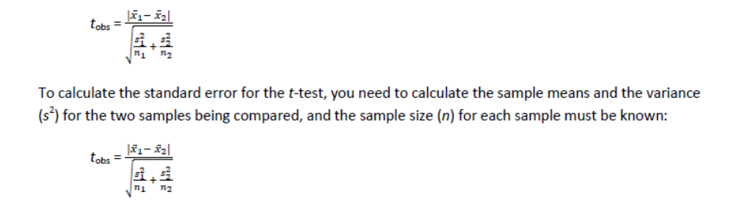
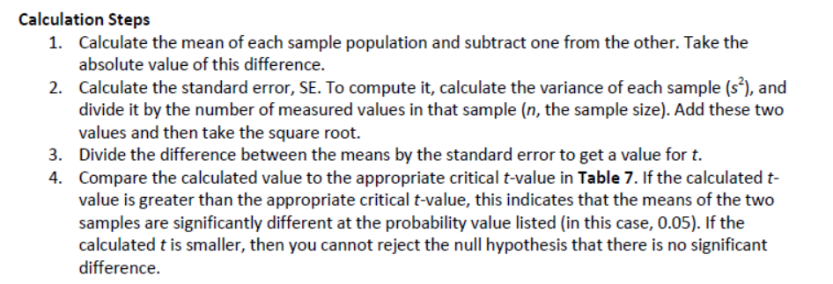
A t-test calculates a single statistic, t, which is compared to a critical t-statistic (tcrit). Table 7 shows tcrit for different degrees of freedom for a significance value of 0.05. The degrees of freedom is calculated by adding the number of data points in the two groups combined, minus 2. Note that you do not have to have the same number of data points in each group:

Slide 35
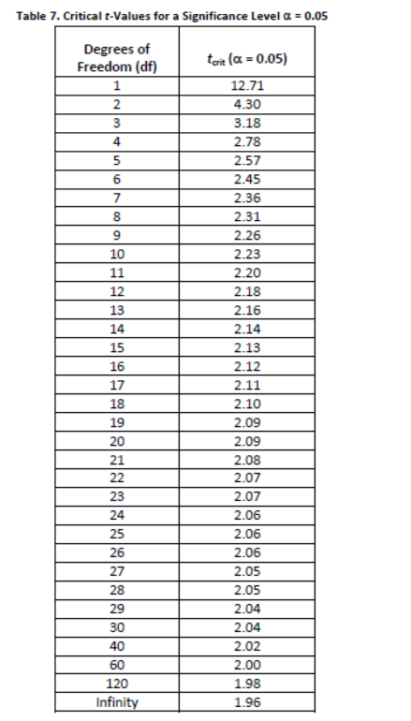
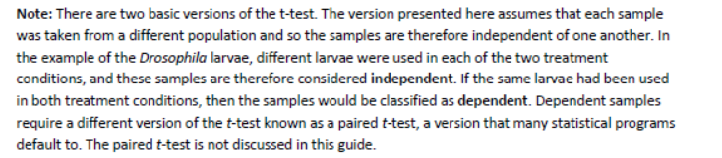

Slide 36
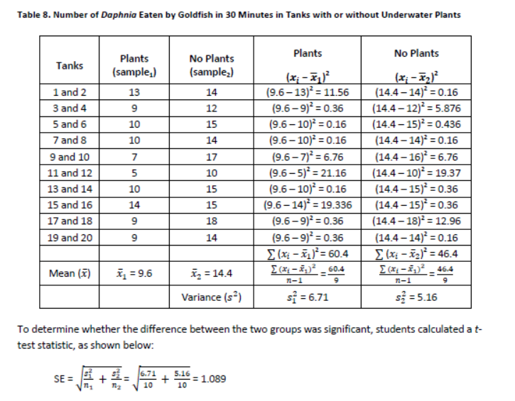
Application in Biology
A small population of crayfish was accidentally released into a shallow pond that was being used in a long-term food-web study. Within a few months, biologists noticed that the underwater plant population was being eaten by the crayfish and had almost disappeared. At the same time, aquatic invertebrates, such as the water flea (Daphnia sp.), were also disappearing. From their earlier work, the biologists knew that the main predator of Daphnia is the goldfish. They hypothesized that the underwater plants had been providing hiding places for the Daphnia, protecting the Daphnia from goldfish. As the underwater plants disappeared, the Daphnia lost their protection. The biologists designed an experiment to test their hypothesis. They placed goldfish and Daphnia together in a tank with underwater plants, and an equal number of goldfish and Daphnia in another tank without underwater plants. They then counted the number of Daphnia eaten by the goldfish in 30 minutes. They repeated this experiment in 10 tanks per condition (i.e., sample size = 10, or n = 10, per group). The results of their experiment and their calculations of experimental error (variance, s2) are in Table 8.

Slide 37
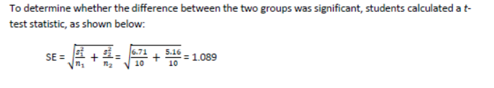
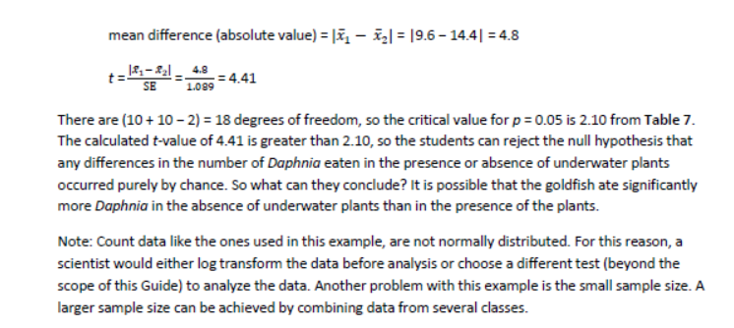

Slide 38
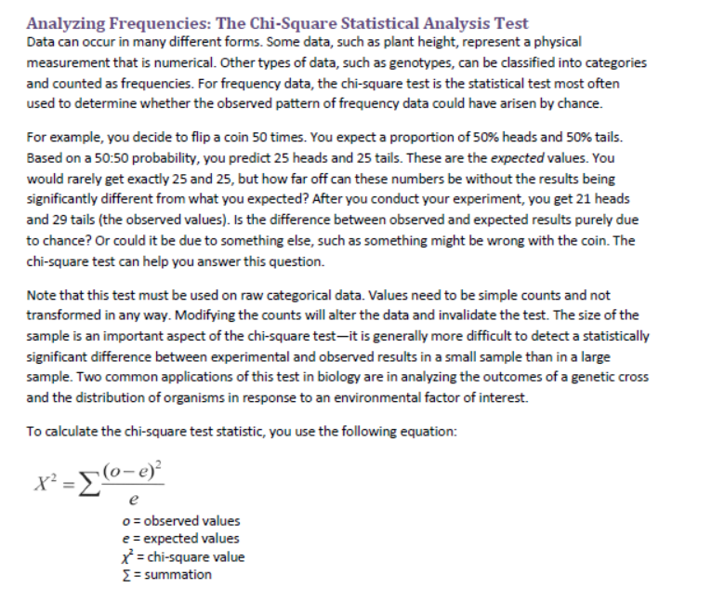

Slide 39
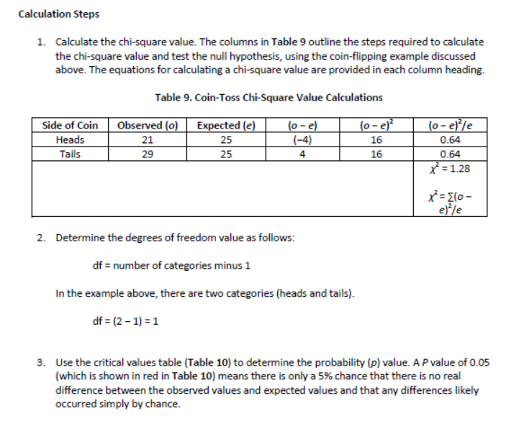

Slide 40
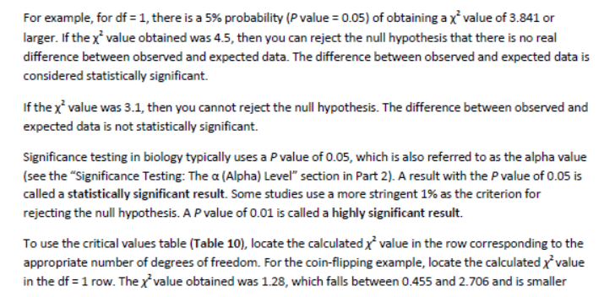
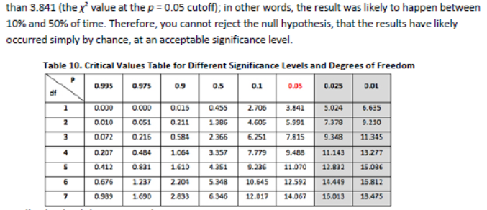

Slide 41
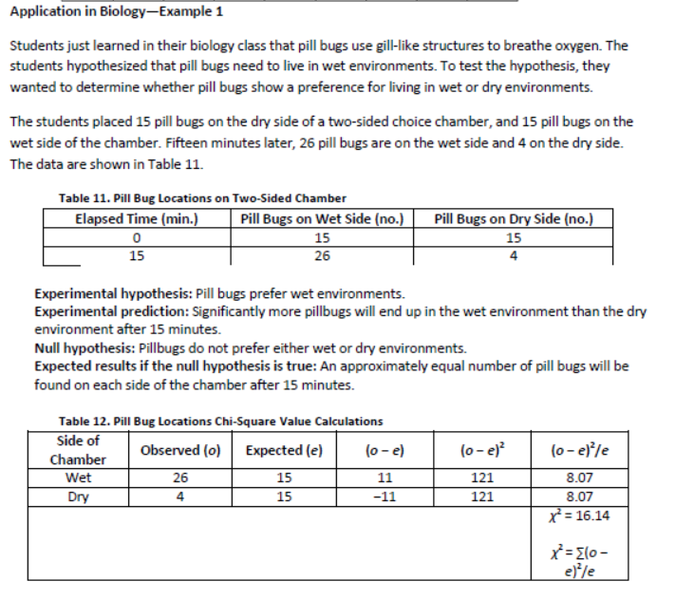

Slide 42
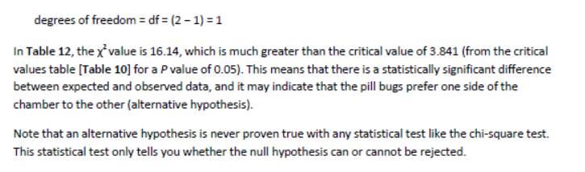

Slide 43
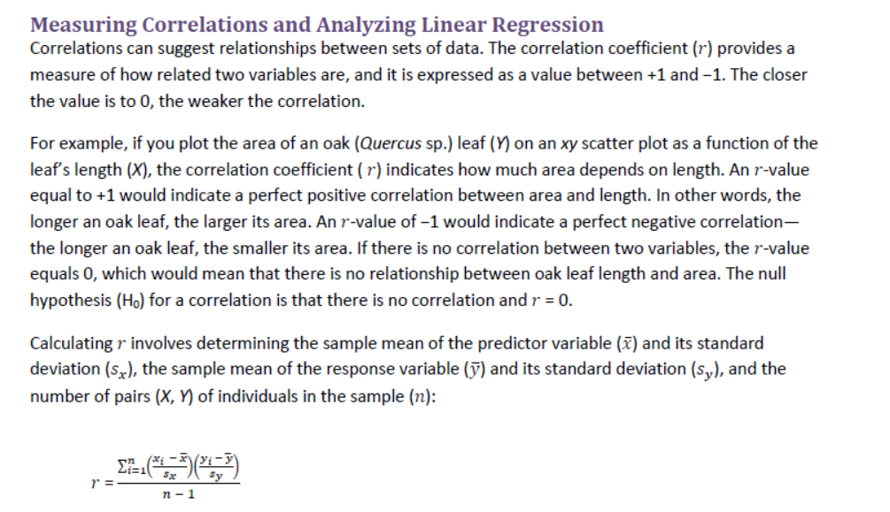

Slide 44
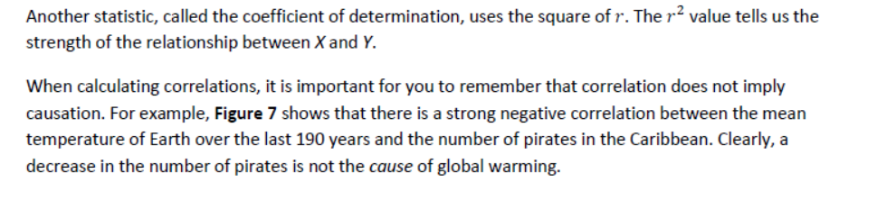
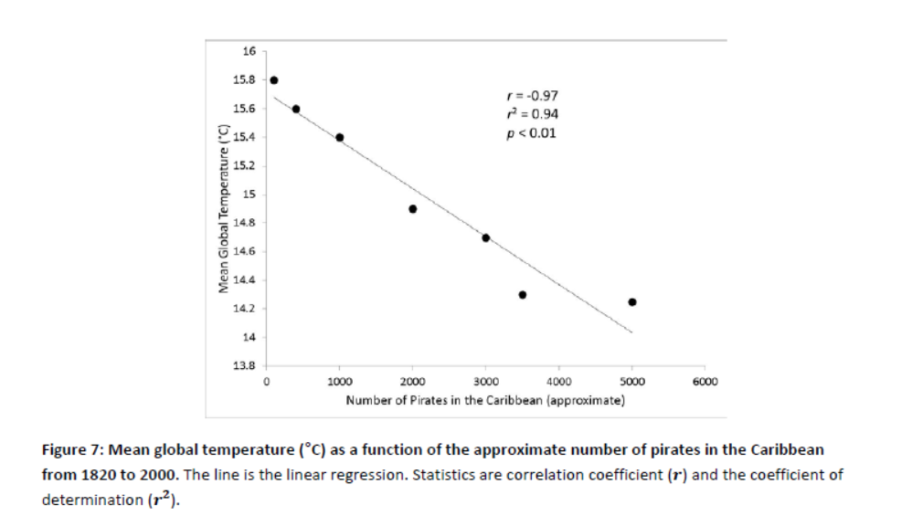

Slide 45
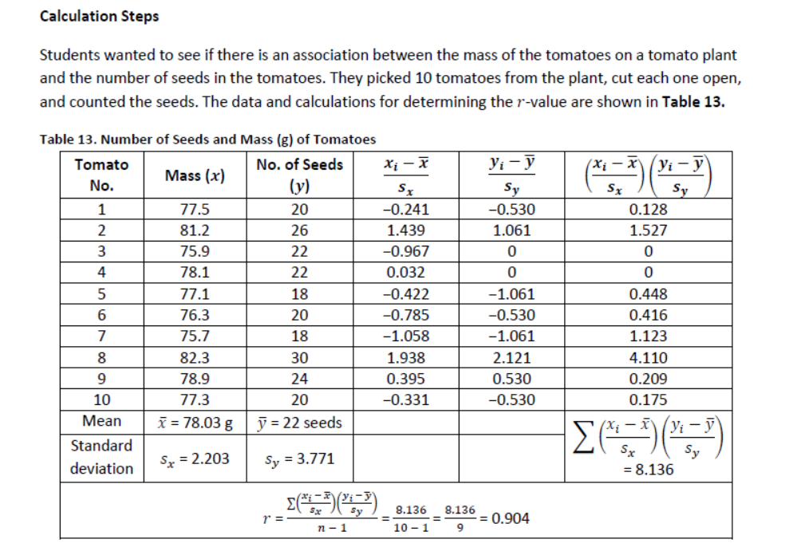

Slide 46
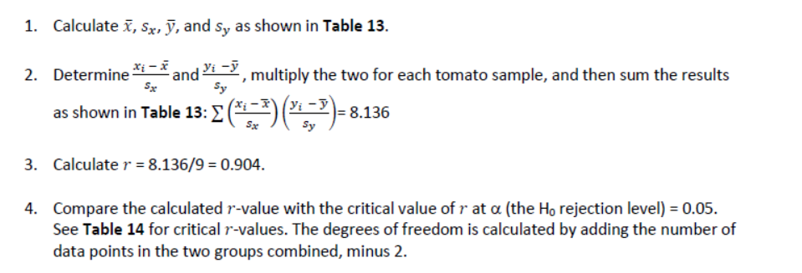
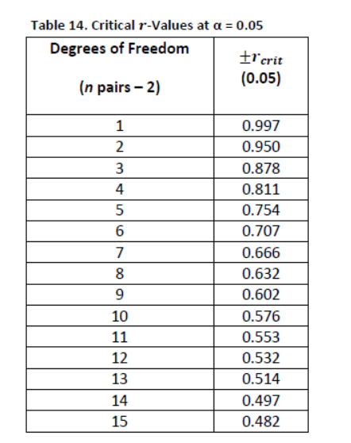
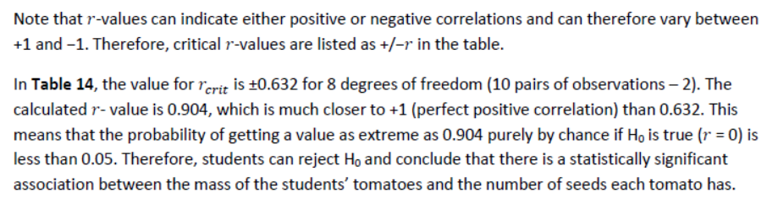

Slide 47
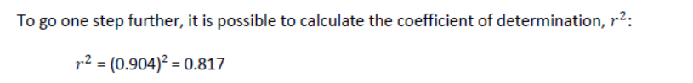
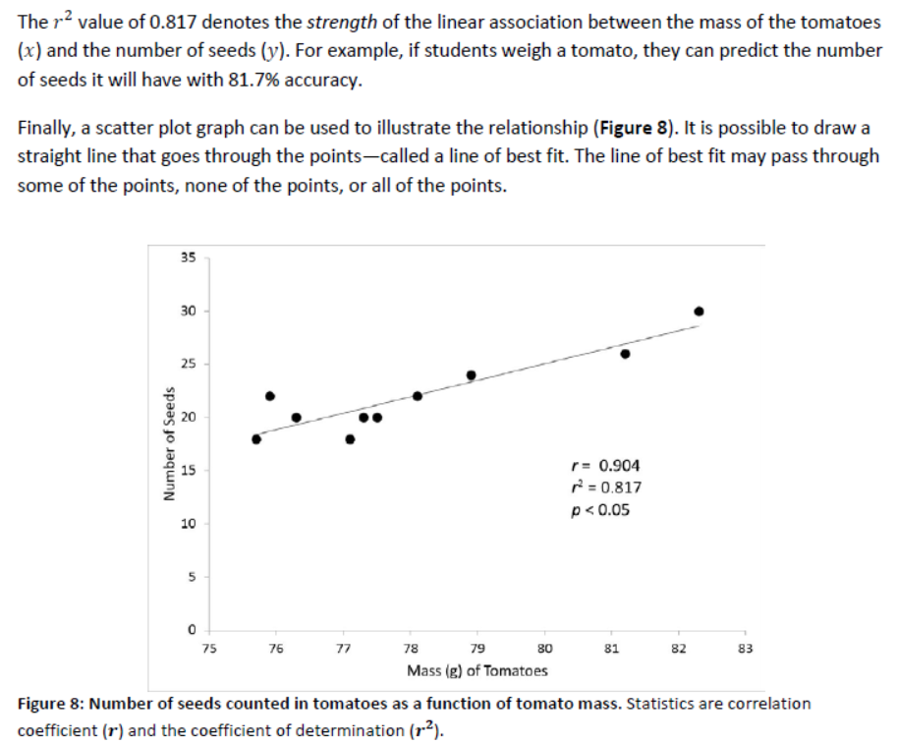

Slide 48
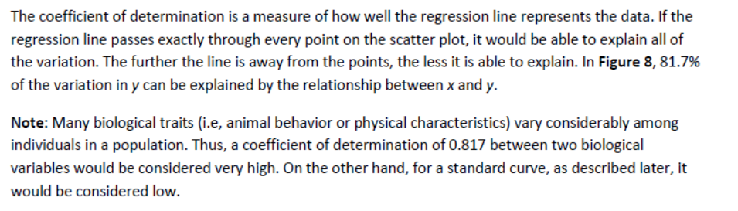

Slide 49
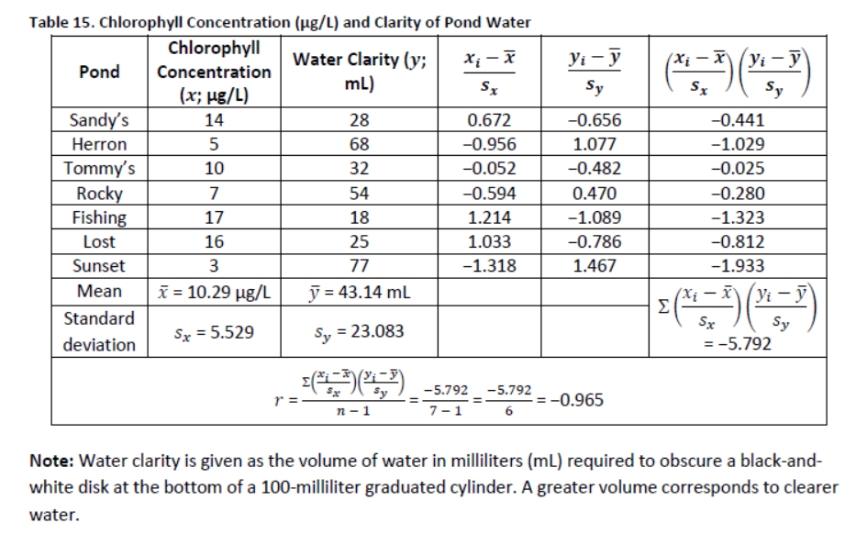
Application in Biology—Example 1
Students were curious to learn whether there is an association between amounts of algae in pond water and the water’s clarity. They collected water samples from seven local ponds that seemed to differ in terms of water clarity. To quantify the clarity of the water, they cut out a small disk from white poster board, divided the disk into four equal parts, and colored two of the opposite parts black; they then placed the disk in the bottom of a 100-milliliter graduated cylinder. Working with one sample at a time, they gradually poured water from each water sample into the cylinder until the disk was no longer visible from above. For each sample, they recorded in Table 15 the volume of water necessary to obscure the disk—the more water necessary to obscure the disk, the clearer the water. As a proxy for algae concentration, they extracted chlorophyll from the water samples and used a spectrophotometer to determine chlorophyll concentration (Table 15).

Slide 50
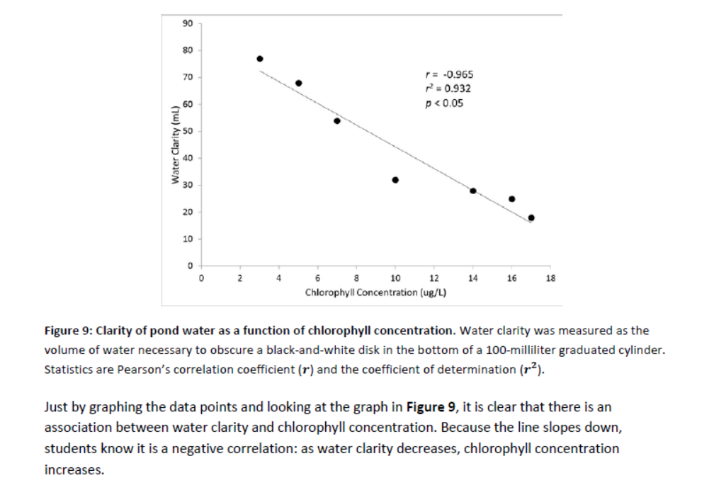

Slide 51
Just by graphing the data points and looking at the graph in Figure 9, it is clear that there is an association between water clarity and chlorophyll concentration. Because the line slopes down, students know it is a negative correlation: as water clarity decreases, chlorophyll concentration increases.
When students calculate 𝑟, they get a value of −0.965, which is a strong correlation (with −1 being a perfect negative correlation). They can confirm this by checking the critical 𝑟-value on Table 14, which is ±0.754 for 5 degrees of freedom (7 – 2) with a 0.05 confidence level. Since the 𝑟 of −0.965 is closer to −1 than 𝑟𝑐𝑟𝑖𝑡 −0.754, they can conclude that the probability of getting a value as extreme as −0.965 purely by chance is less than 0.05. Therefore, they can reject H0 and conclude that chlorophyll concentration and water clarity are significantly associated.
The coefficient of determination (𝑟2) is 0.932, which indicates that students can predict water clarity based on chlorophyll concentration with 93.2% accuracy.

Slide 52
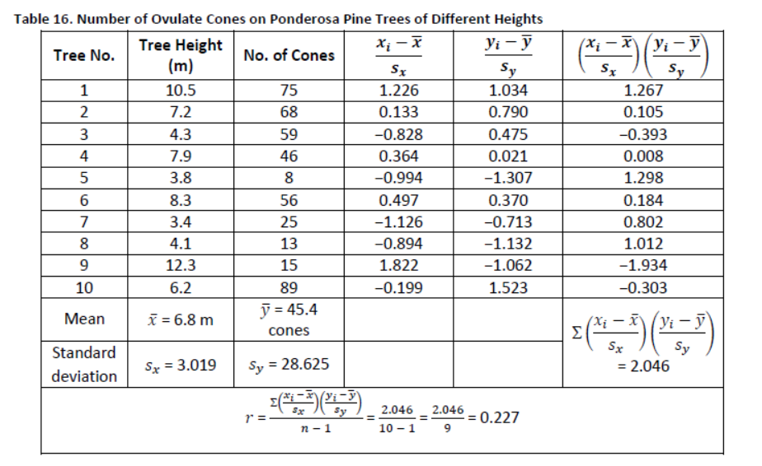
Application in Biology—Example 2
Students noticed that some ponderosa pine trees (Pinus ponderosa) on a street have more ovulate cones (female pinecones) than other ponderosa pine trees. They reasoned that older, and therefore taller, trees should have more cones than younger, shorter trees.
To determine the height of a tree, they used the “old logger” method. A student held a stick the same length as the student’s arm at a 90° angle to the arm and backed up until the tip of the stick “touched” the top of the tree. The distance the student was from the tree equaled the height of the tree. Using this method, the students measured the heights of 10 trees. Then, using binoculars, they counted the number of ovulate cones on each tree and recorded the data in Table 16.

Slide 53
